Slide 1

SE577:Software Architecture
Week 1: Course Overview
Dr. Brian Mitchell
Summer 2021
Drexel University

Slide 2
About the Instructor
Dr. Brian Mitchell
Professor in Computer Science
Background
B.S., M.S., and Ph.D. in Computer Science
M.E. in Computer and Telecommunication Engineering
Involved with CS Department Teaching, Research and Industry collaboration since 1997
Ph.D. work in Software Architecture Recovery
Contact Information
Email: bmitchell@Drexel.edu
Office Hours: by appointment
Webpage: https://www.cs.drexel.edu/~bmitchell/
Course Slack Workspace: https://drexel-se577-2022.slack.com/

Slide 3
Teaching Assistant Information
Mr. Sean Grimes (spg63@drexel.edu)
Office Hours: TBD

Slide 4
About this course
Objectives
Teach students about the knowledge, duty, and skills needed by software architects
Teach students the essential skills of software architecture modeling and analysis
Teach students architecture patterns and styles
Teach students how to specify and analyze quality attributes
Teach students how to analyze architecture embodied in open source projects.
Teach students advanced topics in architectural design.

Slide 5
About this course
Learning outcomes: students completing this course should be able to:
Apply architectural principles and skills to create software systems
Model software architecture and analyze various trade-offs.
Apply architectural patterns to solve real problems
Identify architectural styles in open source projects
Analyze software requirements and choose proper architecture styles.
Reason about architecture quality attributes.

Slide 6

Learning Material
Textbook:
“Software Architecture in Practice”
4th Edition, by Len Bass, Paul Clements, Rick Kazman

Slide 7

Learning Material
Reference Book 1:
“Software Engineering Design: Theory and Practice”
First Edition, by Carlos Otero

Slide 8

Learning Material
Reference Book 2:
“Software Architecture: Foundations, Theory, and Practice”
First Edition, by R. N. Taylor, N. Medvidovic, E. M. Dashofy

Slide 9
Assignments, Assessments, and Evaluations
Group assignment: students need to design and implement a non-trivial software project, as a group, and demonstrate their ability to:
Design, analyze, and implement software architecture
Apply architecture patterns to achieve extensibility
Reason about various architecture quality attributes
Individual assignment: the students should be able to recognize and analyze the architecture of a non-trivial open-source system.

Slide 10
Assignments, Assessments, and Evaluations
Grading Component:
Individual Homework (3): 40%
Individual Homework 1 (I-HW1) : 15%
Individual Homework 2 (I-HW2) : 15%
Individual Homework 3 (I-HW1) : 10%
Group Homework (3): 50%
Group Homework 1 (G-HW1): 20%
Group Homework 2 (G-HW2): 20%
Group Presentation (G-HW3): 10%
Peer review
Participation: 10%

Slide 11
Schedule (subject to change)
 |  | Lecture | Assigning Homework | Homework Due date
Week 1 | June 24th | 1. The basics of software architecture and architecting skills | G-H1: form group and Set up Repository
Week 2 | July 1st | 2. Modeling, UML and C4： 4+1 modeling | I-H1: C-S of KWIC pipe and filter | G-H1 Due
Week 3 | July 8th | 3. Fundamental Architecture Styles: C-S, Pipe-Filter, Event Handling | I-H2: C-S C4 KWIC Event Handling | I-H1 Due
Week 4 | July 15th | 4. Fundamental Styles: C-S, Pipe-Filter, Event Handling | I-H3: C-S C4 Calculator Client Server
Week 5 | July 22th | 5. Quality Attributes I |  | I-H2 Due
Week 6 | July 29th | 6. Software Architecture in practice I: Modern SOA and Web Architecture | G-H2: SOA Train Ticket | I-H3 Due
Week 7 | Aug 5th | 7. Quality Attributes II
Week 8 | Aug 12th | 8. Software Architecture in practice II: Cloud computing and Microservices (1) | G-H3: MS Train Ticket | G-H2 Due
Week 9 | Aug 19th | 9. Advanced topics in software architecture |  | G-H3 Design Due
Week 10 | Aug 26th | 10. Project Presentation | G-H4: Project Presentation
Week 11 |  |  |  | G-H3 Due

Slide 12
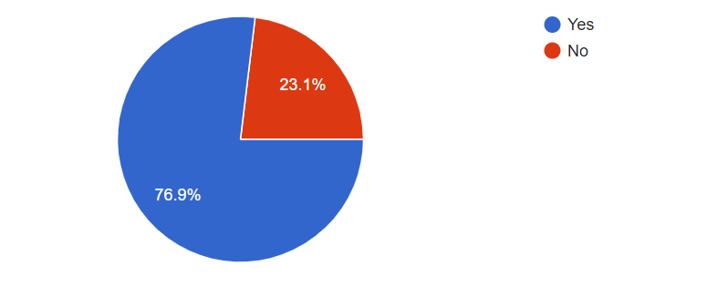
Survey Results:
What is “Software Architecture”?
What are the duties of a " Software Architect"?
Does your team model architecture? (20/26 yes)

Slide 13
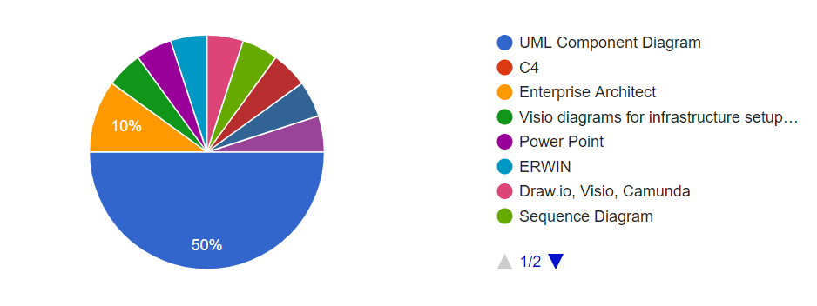
Survey Results:
How does your team model architecture? (10 use UML)

Slide 14
About Software Architecture
The Software Engineering Institute has several hundred definitions on its web-site.
A software architecture is often depicted using an ad hoc box-and-line drawing of the system that is intended to solve the problems articulated by the specification.
Boxes show elements or “parts” of the system.
Lines show relationships among the parts.

Slide 15
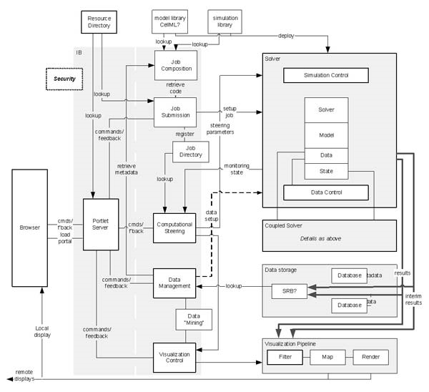
A “Typical” Software Architecture Model

Slide 16
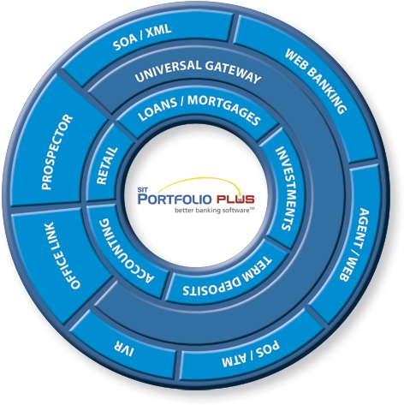
And Another…

Slide 17
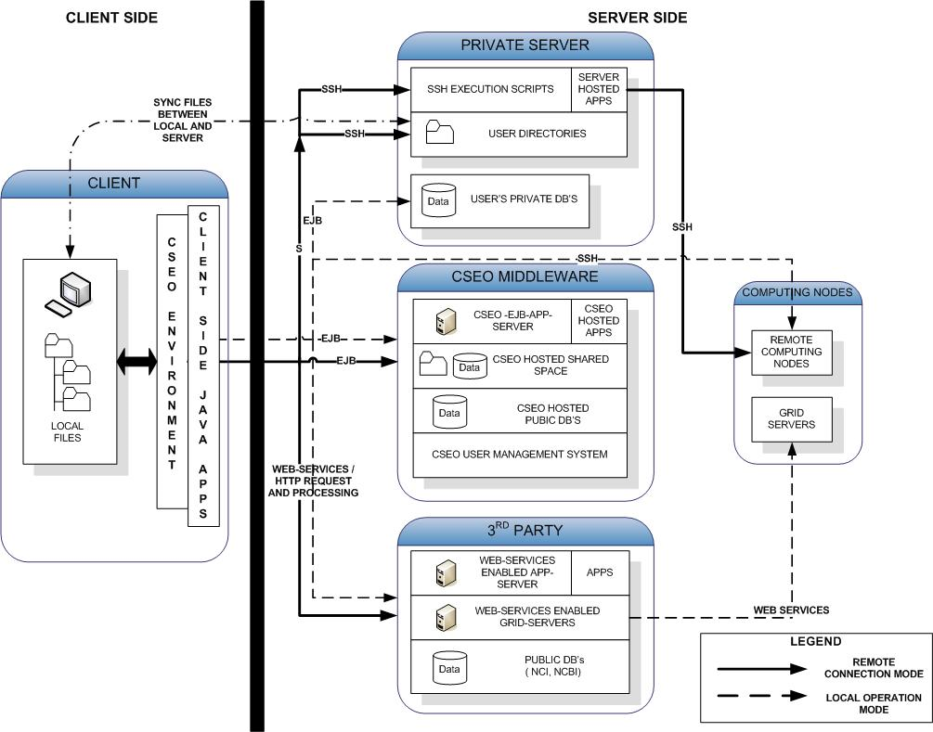
And Another…

Slide 18
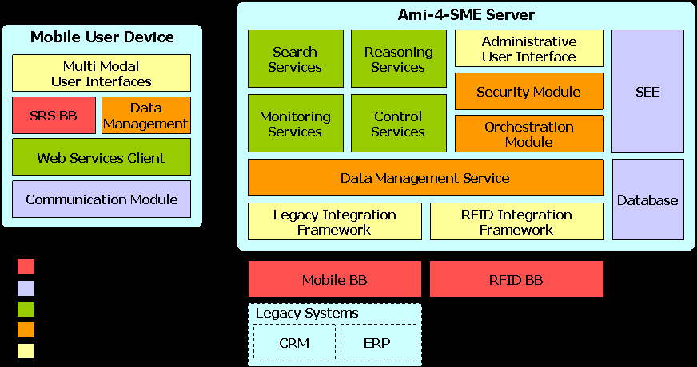
And Another…

Slide 19
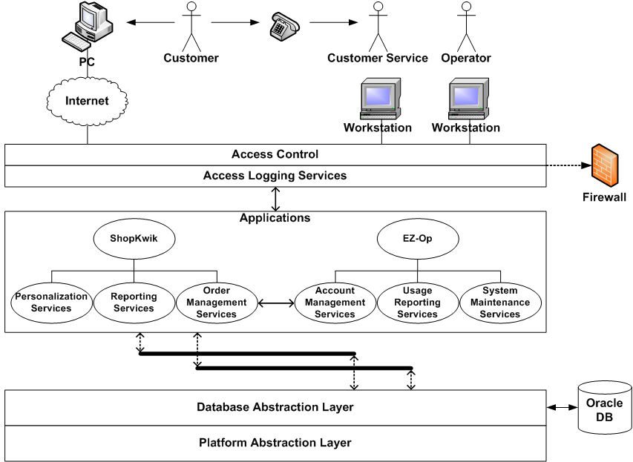
And Another…

Slide 20

What is Software Architecture?
The outcome of design:
The software architecture of a system is the set of structures needed to reason about the system, which comprise software elements, relations among them, and properties of both.

Slide 21
Architecture Is a Set of Software Structures
A structure is a set of elements held together by a relation.
Software systems are composed of many structures, and no single structure holds claim to being the architecture.
There are three important categories of architectural structures.
Module
Component and Connector
Allocation

Slide 22
Module Structures
Some structures partition systems into implementation units, which we call modules.
Modules are assigned specific computational responsibilities, and are the basis of work assignments for programming teams.
In large projects, these elements (modules) are subdivided for assignment to sub-teams.

Slide 23
Component-and-connector Structures
Other structures focus on the way the elements interact with each other at runtime to carry out the system’s functions.
We call runtime structures component-and-connector (C&C) structures.
In our use, a component is always a runtime entity.
Suppose the system is to be built as a set of services.
The services, the infrastructure they interact with, and the synchronization and interaction relations among them form another kind of structure often used to describe a system.
These services are made up of (compiled from) the programs in the various implementation units – modules.

Slide 24
Allocation Structures
Allocation structures describe the mapping from software structures to the system’s environments
organizational
developmental
installation
Execution
For example
Modules are assigned to teams to develop, and assigned to place in a file structure for implementation, integration, and testing.
Components are deployed onto hardware in order to execute.

Slide 25
Which Structures are Architectural?
A structure is architectural if it supports reasoning about the system and the system’s properties.
The reasoning should be about an attribute of the system that is important to some stakeholder.
These include
functionality achieved by the system
the availability of the system in the face of faults
the difficulty of making specific changes to the system
the responsiveness of the system to user requests,
many others.

Slide 26
Architecture is an Abstraction
An architecture comprises software elements and how the elements relate to each other.
An architecture specifically omits certain information about elements that is not useful for reasoning about the system.
It omits information that has no ramifications outside of a single element.
An architecture selects certain details and suppresses others.
Private details of elements—details having to do solely with internal implementation—are not architectural.
The architectural abstraction lets us look at the system in terms of its elements, how they are arranged, how they interact, how they are composed, what their properties are that support our system reasoning, and so forth.
This abstraction is essential to taming the complexity of an architecture.
We simply cannot, and do not want to, deal with all of the complexity all of the time.

Slide 27
Every System has a Software Architecture
Every system comprises elements and relations among them to support some type of reasoning.
But the architecture may not be known to anyone.
Perhaps all of the people who designed the system are long gone
Perhaps the documentation has vanished (or was never produced)
Perhaps the source code has been lost (or was never delivered)
An architecture can exist independently of its description or specification.
Documentation is critical.

Slide 28
Architecture Includes Behavior
The behavior of each element is part of the architecture insofar as that behavior can be used to reason about the system.
This behavior embodies how elements interact with each other, which is clearly part of the definition of architecture.
Box-and-line drawings that are passed off as architectures are not architectures at all.
When looking at the names of the a reader may well imagine the functionality and behavior of the corresponding elements.
But it relies on information that is not present – and could be wrong!
This does not mean that the exact behavior and performance of every element must be documented in all circumstances.
Some aspects of behavior are fine-grained and below the architect’s level of concern.
To the extent that an element’s behavior influences another element or influences the acceptability of the system as a whole, this behavior must be considered, and should be documented, as part of the software architecture.

Slide 29
Physiological Structures
The neurologist, the orthopedist, the hematologist, and the dermatologist all have different views of the structure of a human body.
Ophthalmologists, cardiologists, and podiatrists concentrate on specific subsystems.
The kinesiologist and psychiatrist are concerned with different aspects of the entire arrangement’s behavior.
Although these views are pictured differently and have different properties, all are inherently related, interconnected.
Together they describe the architecture of the human body.
So it is with software!

Slide 30
Physiological Structures

Slide 31
Structures and Views
A view is a representation of a coherent set of architectural elements, as written by and read by system stakeholders.
A view consists of a representation of a set of elements and the relations among them.
A structure is the set of elements itself, as they exist in software or hardware.
In short, a view is a representation of a structure.
For example, a module structure is the set of the system’s modules and their organization.
A module view is the representation of that structure, documented according to a template in a chosen notation, and used by some system stakeholders.
Architects design structures. They document views of those structures.

Slide 32
What Information is Missing in previous “models” ?
What are the elements?
What do the elements actually do?
What are the connections? What are their properties?
What is the significance of the layout?

Slide 33
Definitions we will use in this class
Software Architecture (SE 577): Relations among Components
Components: independently deployable and executable units
Component-and-Connector view
Allocation view
Software Design (SE 575) : Relations among modules
Modules: independent task assignments
Module view
Architecture Patterns/Styles (SE 577):
A Component-and-Connector level solution
Design Patterns (SE 575):
A module level solution

Slide 34
Three dimensions for each product
For each architecture styles
For each homework submissions
Product
Models
Quality Attributes

Slide 35
What does a Software Architect do?
Architects do a variety of things
They design
They draw
They write
They speak
They calculate
They manage

Slide 36
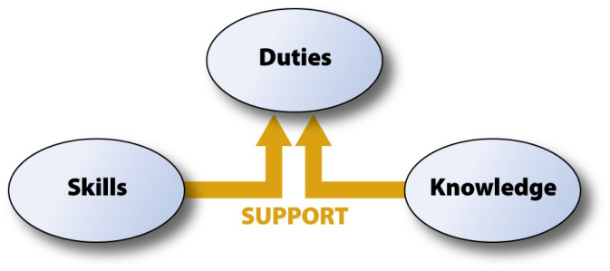
The Duty, Skill, and Knowledge of a Software Architect
Sample 1:
Sample 2:
Duty: design the architecture
Skill: ability to think abstractly
Knowledge: patterns and tactics
Duty: documenting the architecture
Skill: ability to write clearly
Knowledge : ISO Standard 42010
http://www.sei.cmu.edu/architecture/research/previousresearch/duties.cfm

Slide 37
About Software Development Team
Surgical team
“The surgeon…a chief programmer. He personally defines the functional and performance specifications, designs the program, codes it, tests it, and writes its documentation…. He needs great talent, ten years experience, and considerable systems and application knowledge, whether in applied mathematics, business data handling, or whatever.”
Conceptual integrity
“Conceptual integrity in turn dictates that the design must proceed from one mind, or from a very small number of agreeing resonant minds.”

Slide 38
1St Group Assignment (Due next week)
Check with your team members
If you need to make adjustment, please let me know no later than tomorrow EOB.
Assign Roles to each team member for group assignments:
Architect (Surgeon) (1)
Developer (1-2)
Tester (1-2)
Setup testing framework and do testing
Admin (1) (Optional)
Organize meetings, manage wiki, documentations, etc.
A member can have multiple roles, but a team can only have one Architect.
Set up a GitHub repo for your group assignments
Group assignments will be available by Sunday when groups are settled.

